Slide 1
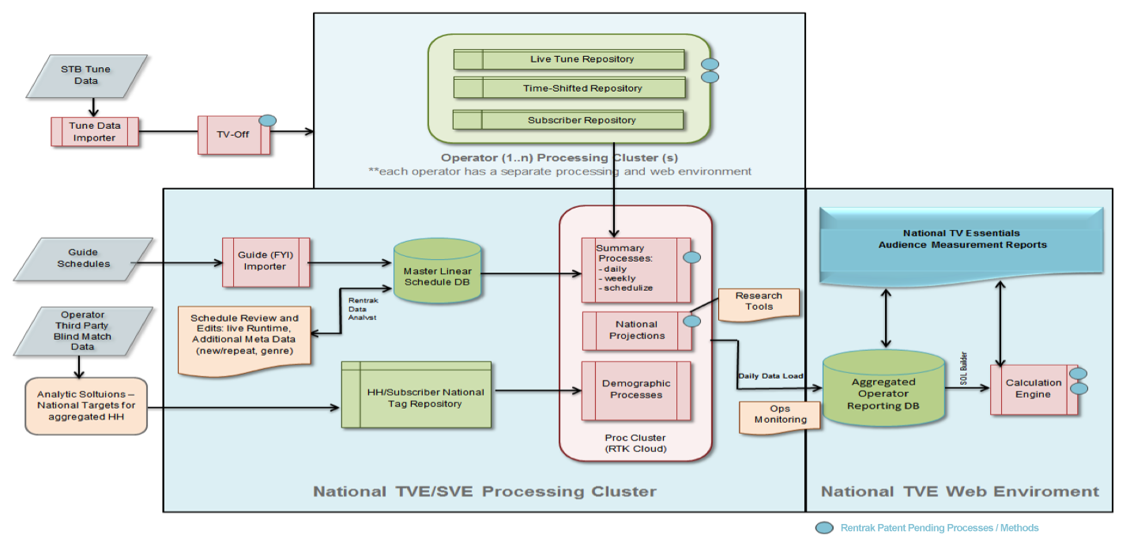
Consumer TV - Data Input Process (DIP)

